Slide 1


Innovation Laboratory
AE39201
ATTENUE
Smart Attendence System
Intermidiate Evaluation

Slide 2
2
OVERVIEW
Introduction
Problem
Solution
Steps
Progress
Future Aspects
Attenue | IIT Kharagpur

Slide 3
3
INTRODUCTION
The Smart Attendance System using Computer Vision is an automated solution designed to streamline the process of marking attendance in classrooms. By leveraging face recognition technology, the system enables professors to capture a photo of the class, which is then processed to identify students and automatically record their attendance. This eliminates the need for manual roll calls, saves time, and enhances accuracy, providing a modern, tech-driven approach to classroom management.
Attenue | IIT Kharagpur

Slide 4
4
PROBLEM
First Problem
In large classrooms, taking attendance manually consumes valuable lecture time and often results in errors, such as missed entries or incorrect marking.
Manual Attendance is Time-Consuming and Prone to Errors:
Attenue | IIT Kharagpur
Second Problem
Traditional attendance methods allow for the possibility of proxy attendance, where students can mark attendance for absent peers, leading to inaccurate records.
Lack of a Reliable System to Prevent Proxy Attendance:

Slide 5
5
SOLUTIONS
1
Automated Attendance through Face Recognition: By using computer vision to automatically identify and record the attendance of students from a classroom photo, the system reduces the time spent on manual attendance.
Attenue | IIT Kharagpur
Real-Time Processing and Instant Record Generation: The system processes the class photo in real-time, generating attendance records almost instantly, preventing delays and minimizing disruption during lectures.
2
3
Elimination of Proxy Attendance: With facial recognition technology, each student is uniquely identified based on their facial features, ensuring that only present students are marked, thereby preventing proxy attendance.

Slide 6
6
STEPS
MAKING OF COMPUTER VISION MODEL
MAKING OF APPLICATION
INTEGRATE THE MODEL WITH THE APPLICATION
IoT
Attenue | IIT Kharagpur

Slide 7
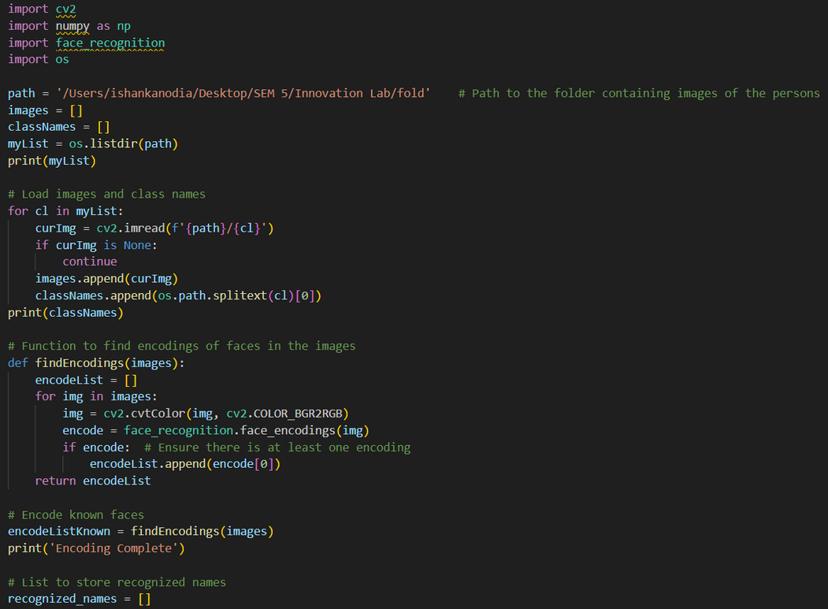
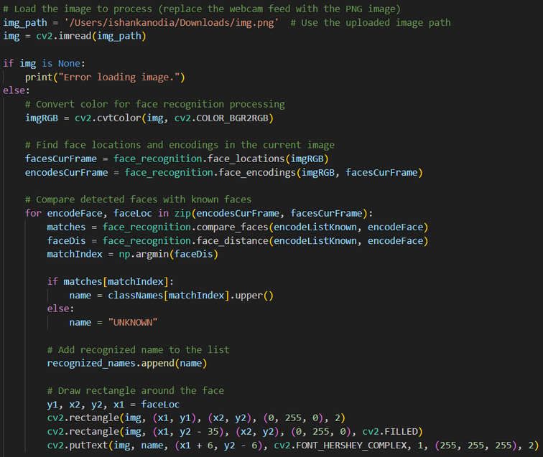
7
PROGRESS - MODEL
We have used computer vision to make our model. Our model takes images of the students and recognizes them in the image provided by the professor.
Attenue | IIT Kharagpur

Slide 8
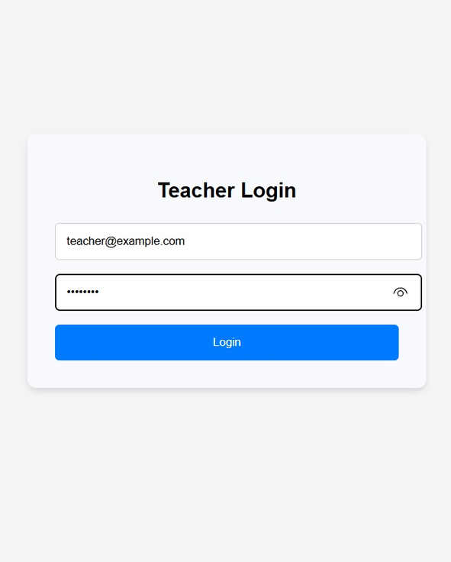
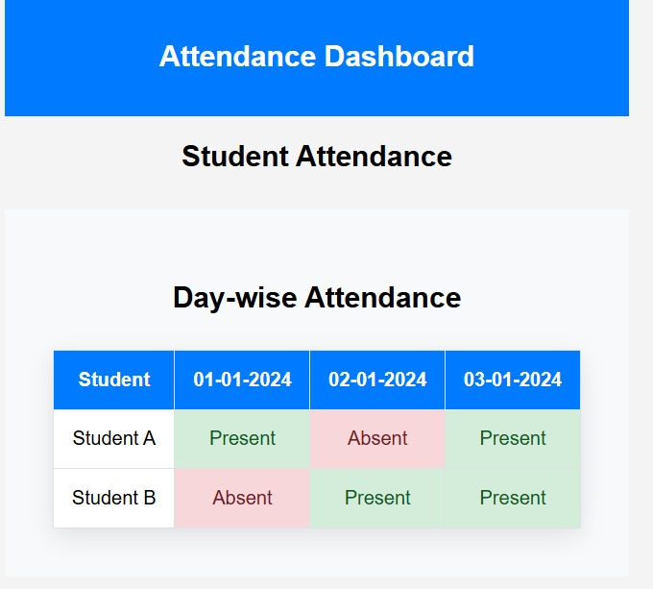
7
PROGRESS - APPLICATION
This is the application we will be using for the attendance
Attenue | IIT Kharagpur

Slide 9
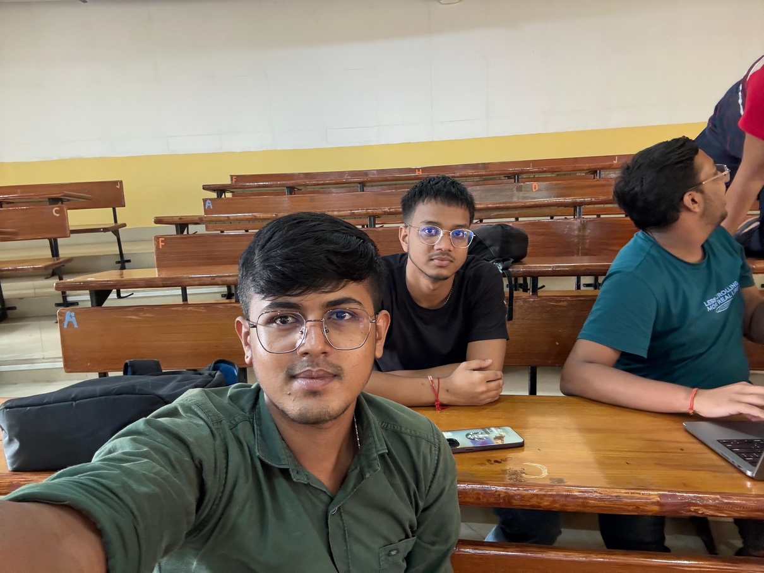
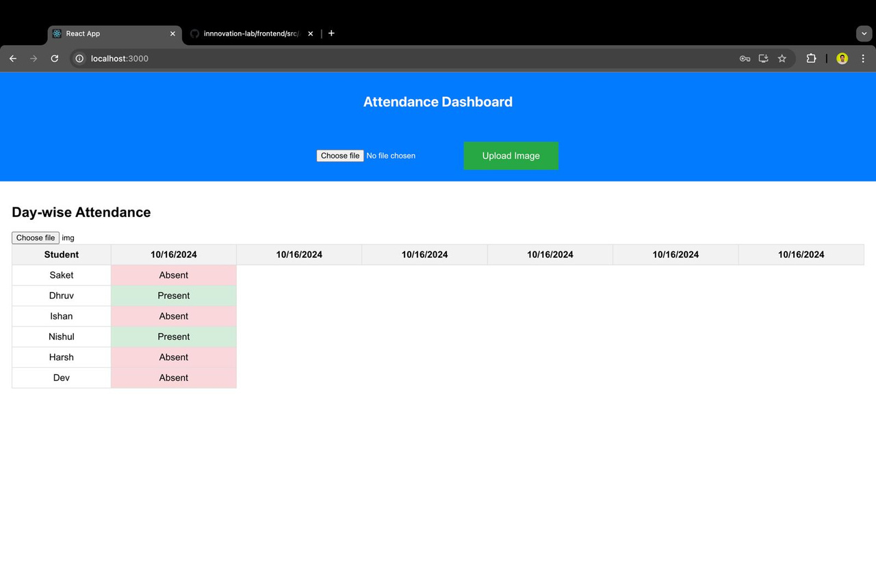
8
PROGRESS - INTEGRATION
We have integrated our model which takes input image and marks the attendance.
Attenue | IIT Kharagpur

Slide 10
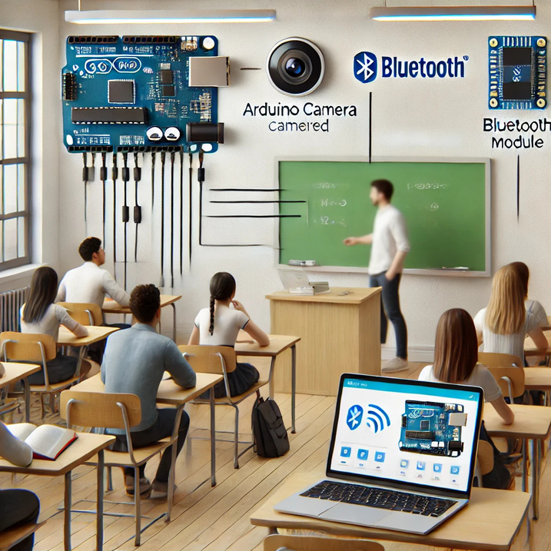
9
FUTURE ASPECTS(IOT)
In the future, the system can be enhanced by integrating hardware components like an Arduino camera and Bluetooth module to further automate and streamline the process. With an Arduino camera mounted in the classroom, attendance photos can be captured automatically at specific intervals, removing the need for manual picture-taking. Additionally, integrating a Bluetooth module can allow students’ devices to communicate with the system, confirming their presence in the classroom. This combination of hardware and software automation would lead to a fully hands-free, efficient, and tech-driven attendance system, ensuring real-time tracking with minimal intervention.
Attenue | IIT Kharagpur

Slide 11
THANK YOU
Attenue | IIT Kharagpur

